Slide 1

The Brand
Campaign Performance Analysis

Slide 2
Executive Summary
The latest campaign aims to highlight the superior display quality of the new phone model compared to existing devices. By leveraging digital platforms, the campaign is designed to guide users through the awareness, consideration, and performance stages of the customer journey.
Our analysis, based on the provided campaign data extract, reveals critical insights into campaign performance and user engagement trends.
Media Tactics Overview
Campaign Run Time: January 3–21, 2023
Markets Targeted: US, Worldwide (Japan,India,Canada,UAE,UK,)
Channels: Twitter, Snapchat, DV360 DSP
Creative Products: Phone Modelabc Plus & Phone Modelabc
Creative Dimensions: 1:1 AR, 9:16 AR, 320x480, 414x736, 300x250
CTA: "Upgrade Now" , "None"
Channels : Website(Programmatic Display) & App(Social)
Spend Categories : High ,Medium and Low

Slide 3
Data Anomalies and Patterns:
A few anomalies, such as spikes in cost-per-click and missing values in certain touchpoint data, were identified.
Zeros/missing values in key metrics, skewed distributions.
Data was segmented into three segments based on spend. This was to enhance analysis of outliers without removing them
Insights by Market:
CTR was higher worldwide than in the US.
Clicks increased with spending, but CTR had a weak negative correlation (-0.16) with spend.
High-spend campaigns had fewer creative variations, while low-spend campaigns used diverse combinations.
Medium spend campaigns had the highest CTR at a low cost
Campaigns on the app produced a higher CTR at a lower CPC
App Campaigns Are More Cost-Efficient Than Web Campaigns
Attributes of high performing campaigns : Creative Dimensions: 1:1 AR,No Creative carrier,No creative copy, Call to Action : Upgrade Now, Placement :In-Feed, Publisher : Twitter
3.Recommendations:
Refine data collection processes.
Leverage high-performing attributes for future campaigns

Slide 4
KPIs By Spend Segmentation
Low Spend Campaigns
Medium Spend Campaigns
Avg CTR: 0.41% | Avg Spend: $7.85 | Avg Clicks: 24
Avg CPC : 0.44 | Avg CPCV : 0.0016
Avg CTR: 0.76% | Avg Spend: $20.05 | Avg Clicks: 70
Avg CPC :0.37 | Avg CPCV : 0.0024
High Spend Campaigns
Avg CTR: 0.24% | Avg Spend: $515.38 | Avg Clicks: 515
Avg CPC : 0.96 | Avg CPCV : 0.0022

Slide 5
Campaign Comparison(Region)
There were no low spend campaigns in the US
Two platforms were used for the campaigns viz App and Web
Both App and Web campaigns show peak CTR in the Medium Spend category for Worldwide (App: 0.48, Web: 0.49)
In both regions, High Spend campaigns see an increase in CPC and a decline in CTR, particularly for Web campaigns (Worldwide CTR: 0.17)
Across all spend categories, App campaigns consistently deliver lower CPC and CPCV values, especially in Low Spend ( App CPCV: 0.0035 vs. Web CPCV: 0.0035 for Worldwide)

Slide 6
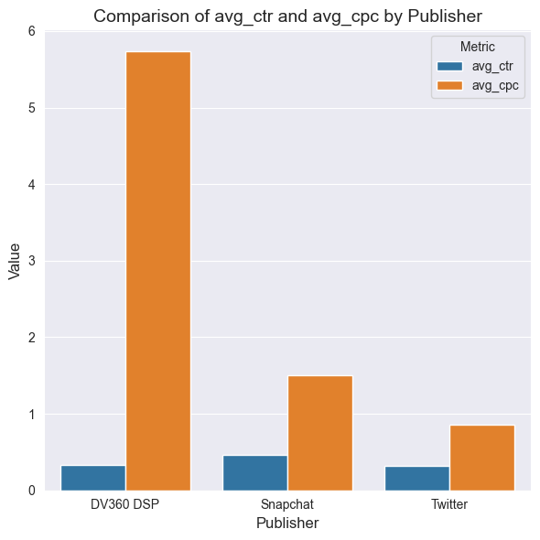
Publisher Comparison( CTR Vs CPC)
Three publishers were used
Twitter has the lowest avg CTR but a low CPC
It is also the most used publisher in the campaigns
DV360 DSP has the highest CPC and is the least used publisher

Slide 7
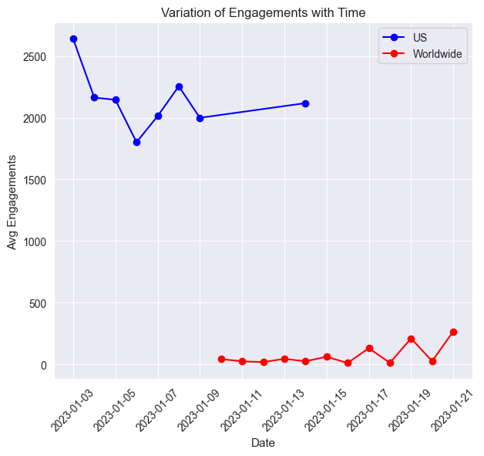
Engagement Trends(Region)
The US has overall high engagement compared to worldwide
Engagement decreases over time the more the campaign runs in the US, inversely the engagement levels increase the longer the campaigns run worldwide

Slide 8
Campaign Tactics
Attributes Of Top Performing Low Spend Campaigns
Creative Dimensions : 80% 1:1 AR and 20% 9:16 AR
Creative Carrier : 80% None, 20% Other(Rakuten and Softbank)
Audience Targeting Segment : 70% Broad Audience, 30% Photography
Creative Copy : 70% None,30 % Other(phModel8,phModelx-na-pal,phModelx)
Creative CTA : 90% Upgrade Now, 10% None
Placement Type : 80% In-Feed, 20% User Stories
Top markets : Worldwide
Publisher : 80% Twitter , 20% Snapchat
Use of various creative combinations
A magazine is a periodical publication, which can either be printed or published electronically.
A magazine is a periodical publication, which can either be printed or published electronically.

Slide 9
Campaign Tactics
Attributes Of Top Performing High Spend Campaigns
Creative Dimensions : 1:1 AR
Creative Carrier : None
Audience Targeting Segment : Broad Audience
Creative Copy : 90 % phModeldef , 10 % None
Creative CTA : 90% Upgrade Now, 10% None
Placement Type : In-Feed
Top markets : US
Publisher : Twitter
Use of narrow creative combinations
A magazine is a periodical publication, which can either be printed or published electronically.
A magazine is a periodical publication, which can either be printed or published electronically.

Slide 10
Campaign Tactics
Attributes Of Top Performing Medium Spend Campaigns
Creative Dimensions : 60% 1:1 AR
Creative Carrier : None
Audience Targeting Segment : Broad Audience
Creative Copy : Various creative copy but mostly None(40%)
Creative CTA : 80% Upgrade Now, 20% None
Placement Type : 60% In-Feed, 40% Other(User Stories, Banner etc)
Top markets : Worldwide(mainly India and UK)
Publisher : 60 % Twitter ,30% Snapchat
Use of diverse creative combinations
A magazine is a periodical publication, which can either be printed or published electronically.
A magazine is a periodical publication, which can either be printed or published electronically.

Slide 11
Platform Comparison
App had a higher average CTR for all spend categories(0.37%) and a lower cost per click(CPC) than the website
Platform | Spend Category | CTR | CPC | CPCV | Key Insight
App | Low Spend | 0.32 | 0.71 | 0.0035 | Cost-effective with steady CTR.
App | Medium Spend | 0.48 | 1.4 | 0.0039 | Best CTR performance.
App | High Spend | 0.36 | 1.1 | 0.0032 | CPC increases; CTR slightly drops.
Web | Low Spend | 0.17 | 0.71 | 0.0035 | Efficient for low budgets.
Web | Medium Spend | 0.49 | 1.4 | 0.0039 | Strong CTR, similar to App.
Web | High Spend | 0.17 | 1.1 | 0.0032 | CTR and cost-efficiency decline.

Slide 12
Platform Comparison(Region)
Region | Platform | Spend Category | CTR | CPC | CPCV | Key Insight
US | App | High Spend | 0.21 | 1 | 0.0022 | Lower CTR but efficient CPCV.
US | Web | High Spend | 0 | 1 | 0.0022 | Stable cost-efficiency with limited CTR.
Worldwide | App | Low Spend | 0.32 | 0.71 | 0.0035 | Strong CTR and cost-efficiency.
Worldwide | App | Medium Spend | 0.48 | 1.4 | 0.0039 | Best overall CTR performance.
Worldwide | App | High Spend | 0.36 | 1.1 | 0.0032 | CPC increases slightly, CTR declines.
Worldwide | Web | Low Spend | 0.17 | 0.71 | 0.0035 | Efficient for low-budget campaigns.
Worldwide | Web | Medium Spend | 0.49 | 1.4 | 0.0039 | Strong CTR similar to App.
Worldwide | Web | High Spend | 0.17 | 1.1 | 0.0032 | Significant drop in CTR; cost-efficiency OK.

Slide 13
Challenges and Opportunities
Challenges
Opportunities
Data gaps: Missing values in views, engagements
Key touchpoints in the user journey are zeros. Data might not have been collected properly
Many efficiency metrics could not be calculated because of zero data points
Skewed distributions: Potential anomalies in clicks ,impressions and spend
Leverage low-cost, high-CTR strategies for scaling.
Campaigns were segmented based on spend ,giving a more robust audience segmenation by varying spend for the different campaigns

Slide 14

Recommendations
Focus on platforms (Twitter, Snapchat) and creative dimensions (1:1 AR, 9:16 AR) with proven high performance.
Focus more on advertising on the app than on the websites
Enhance data collection to address gaps in user journey metrics.
Optimize medium-spend campaigns for better ROI.

Slide 15
Platform Comparison
App had a higher average CTR for all spend categories(0.37%) and a lower cost per click(CPC) than the website
Platform | Spend Category | Avg CTR | Avg CPCV | Avg CPC | Avg Clicks | Avg Impressions | Total Spend (USD)
Website | Low Spend | 0.17 | 0.0026 | 0.31 | 1.67 | 966.33 | 4.73
Website | Medium Spend | 0.49 | 0.016 | 5.62 | 20.2 | 2102.2 | 78.94
Website | High Spend | 0.17 | 0.024 | 9.94 | 6.5 | 3075.25 | 298.13
App | Low Spend | 0.32 | 0.0035 | 0.71 | 11.63 | 3255.74 | 163.51
App | Medium Spend | 0.48 | 0.0039 | 1.44 | 34.6 | 7251.56 | 419.23
App | High Spend | 0.31 | 0.0029 | 1.06 | 234.54 | 102350.96 | 5849.7

